Slide 1

Claude Code

Slide 2

What is Claude Code?
Your AI coding assistant that lives in your terminal
Designed as a CLI-first
Acts as an autonomous coding agent
Can read repo and understand project

Slide 3
CLI-First
Why terminal instead of GUI?
Most development workflows already use the terminal
Easier integration with:
git
docker
package manager
shell commands

Slide 4



Core Capabilities
Edit
Run
Debug
Code editing across multiple files
Running tests to check the code
Analysing logs and debugging in the code

Slide 5
The Brain
Claude code plans steps before acting
choose tools dynamically
evaluates command outputs
adapts strategy during execution

Slide 6
The Agentic Loop
Claude code operates in a reasoning loop:
Understands the user request
Search the repository
Plan a solution
Edit code
Run commands/tests
Evaluate results
Iterate until the task succeeds

Slide 7



The Agentic Loop
Action
Executes tools and commands
Think
Observe
Analyse the task
Inspect results

Slide 8
CLAUDE.md
Repository guide for Claude
Architecture explanations
Coding conventions
Can be created manually or with the /init command
Claude reads it when started

Slide 9
Sub Agents
Specialized internal agents
Gets a specified task from the main agent
Runs in their own context window independently
return the result to the main agent

Slide 10
/Init
Initialize Claude Code in a repository
Scans the repository structure
Generate a CLAUDE.md file

Slide 11
Skills
Pre-written instructions on how to do specific tasks
Activated if the description of task matches the request of the user
Can reference to other files to reduce context

Slide 12
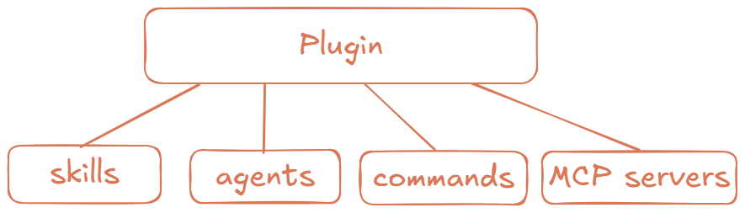
Plugin
A collection of skills, agents, custom commands, MCP servers and more
Easy to share with teammates
Can be installed from a marketplace

Slide 13
Marketplace
Catalog of plugins
Allow you to share your plugins with others
Allow you to download other people’s plugins
Usually stored in git hosts

Slide 14
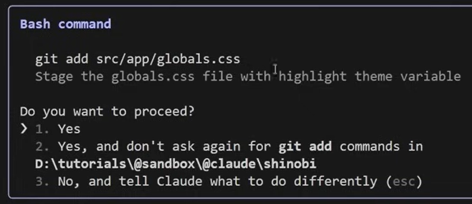
Permissions
Define boundaries- what the agent can and cannot do
Managed via config & CLI- settings.json, permission rules and runtime flags
Controlled by allowed/deny list and default policy
Permission levels: Read-only, Suggest, Full autonomy
Goal: balance automation speed with safety

Slide 15
.claudecodeignore
Similar to .gitignore
Excludes files and directories
Reduce unnecessary context
Improves security

Slide 16
/compact
Summarize long sessions
Preserves key information
Reduces conversation context

Slide 17
Semantic Search
Understands meaning, not just keywords
Use vectors to represent the meaning of the code
Retrieves only relevant parts of the repo
Improves context efficiency
Enables faster and smarter code navigation

Slide 18




Tool set
 | Tool | Abilities
 | File System | Read files Write files Edit files List directories
 | Semantic Search | Converts repo into vectors Retrieve relevant files
 | Terminal and Execution | Run commands Execute scripts Install dependencies
 | Test and Validation | Run tests Check outputs Validate fixes

Slide 19
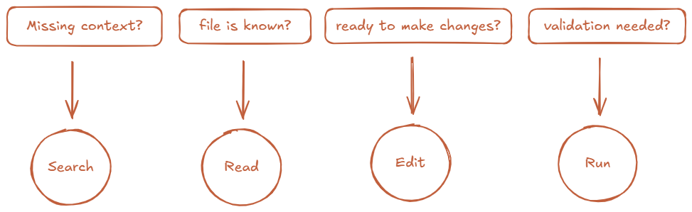
Tool Selection
What information or action do I need next?

Slide 20
Context Management
Analyses the user request to identify relevant files and functions
Use semantic search to fetch the most relevant code chunks
expands context for understanding
Removes redundancy parts to stay within token limits

Slide 21
Thank You For Listening

Slide 22
INTRODUCTION
You can give a brief description of the topic you want to talk about here. For example, if you want to talk about Mercury, you can say that it’s the smallest planet in the entire Solar System

Slide 23
1
ABOUT US
You can enter a subtitle here if you need it

Slide 24

A PICTURE IS WORTH A THOUSAND WORDS

Slide 25


A PICTURE ALWAYS REINFORCES THE CONCEPT
Images reveal large amounts of data, so remember: use an image instead of a long text. Your audience will appreciate it

Slide 26
—SOMEONE FAMOUS
“This is a quote. Words full of wisdom that someone important said and can make the reader get inspired.”

Slide 27
4,498,300,000
Big numbers catch your audience’s attention

Slide 28
24h 37m 23s
333,000.000
386,000 km
Is Jupiter's rotation period
Earths is the Sun’s mass
Is the distance between Earth and the Moon

Slide 29
INFORMATION STATS
10%
50%
Mercury
Venus
It’s the closest planet to the Sun and the smallest in the System
Venus has a beautiful name and is the second planet from the Sun

Slide 30


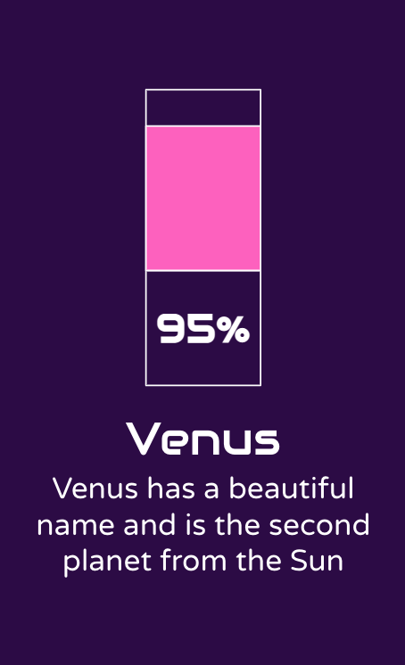
DESKTOP SOFTWARE
You can replace the image on the screen with your own work. Just right-click on it and select “Replace image”

Slide 31
OUR CLIENTS
Venus
It has a beautiful name, but it’s hot
Mars
Despite being red, Mars is a cold place

Slide 32
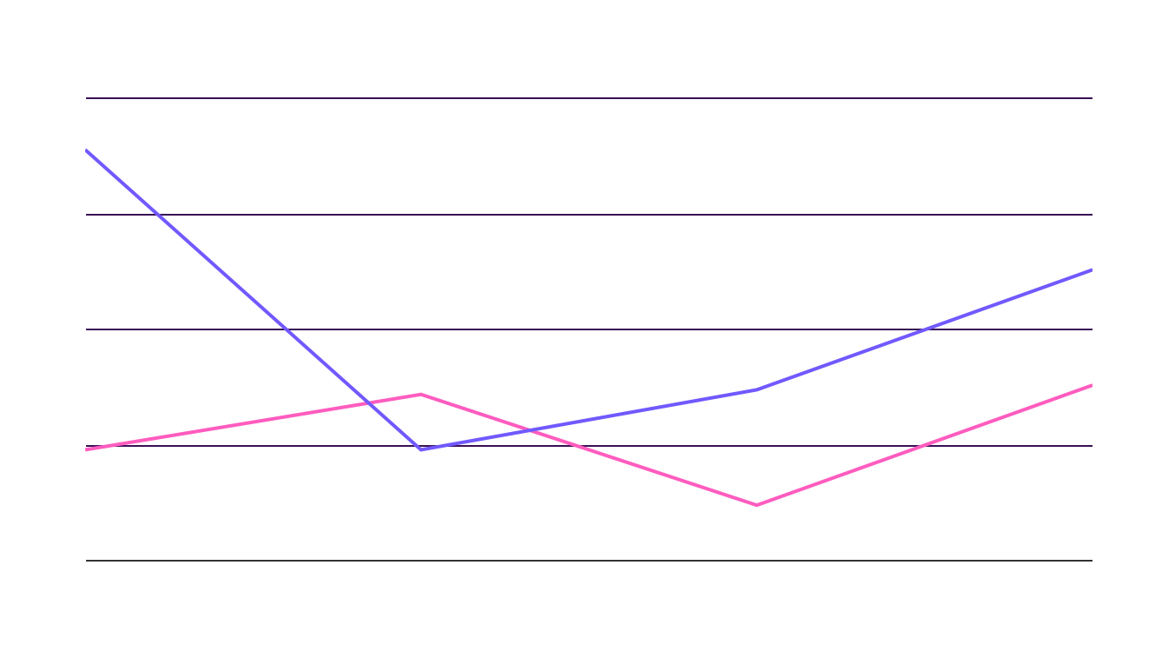
DATA SKILLS GROWTH
Venus
It has a beautiful name, but it’s hot
Mars
Despite being red, Mars is a cold place
Follow the link in the graph to modify its data and then paste the new one here. For more info, click here

Slide 33
THANKS!
Does anyone have any questions?
addyouremail@freepik.com
+91 620 421 838
yourcompany.com
Please keep this slide for attribution

Slide 34
DATA PROTECTION ICON PACK

Slide 35

ALTERNATIVE RESOURCES
Here’s an assortment of alternatives resources within the same style of this template
Gradient violet glowing particles background

Slide 36
RESOURCES
Did you like the resources on this template? Get them for free at our other websites.
Photos:
Creative graphic designer sitting at table
Front view of smiley man holding laptop
African american man front view
Portrait of a young asian businesswoman with her arm crossed looking to camera isolated on white background
Portrait of a young woman showing money sign
Front view of woman using virtual reality headset
Front view of man doing a presentation during a meeting
Vectors:
Elegant shapes of glowing particles background
Icons:
Data Protection icon pack

Slide 37
Instructions for use
If you have a free account, in order to use this template, you must credit Slidesgo by keeping the Thanks slide. Please refer to the next slide to read the instructions for premium users.
As a Free user, you are allowed to:
- Modify this template.
- Use it for both personal and commercial projects.
You are not allowed to:
- Sublicense, sell or rent any of Slidesgo Content (or a modified version of Slidesgo Content).
- Distribute Slidesgo Content unless it has been expressly authorized by Slidesgo.
- Include Slidesgo Content in an online or offline database or file.
- Offer Slidesgo templates (or modified versions of Slidesgo templates) for download.
- Acquire the copyright of Slidesgo Content.
For more information about editing slides, please read our FAQs or visit Slidesgo School:
https://slidesgo.com/faqs and https://slidesgo.com/slidesgo-school

Slide 38
Instructions for use (premium users)
As a Premium user, you can use this template without attributing Slidesgo or keeping the "Thanks" slide.
You are allowed to:
Modify this template.
Use it for both personal and commercial purposes.
Hide or delete the “Thanks” slide and the mention to Slidesgo in the credits.
Share this template in an editable format with people who are not part of your team.
You are not allowed to:
Sublicense, sell or rent this Slidesgo Template (or a modified version of this Slidesgo Template).
Distribute this Slidesgo Template (or a modified version of this Slidesgo Template) or include it in a database or in any other product or service that offers downloadable images, icons or presentations that may be subject to distribution or resale.
Use any of the elements that are part of this Slidesgo Template in an isolated and separated way from this Template.
Register any of the elements that are part of this template as a trademark or logo, or register it as a work in an intellectual property registry or similar.
For more information about editing slides, please read our FAQs or visit Slidesgo School:
https://slidesgo.com/faqs and https://slidesgo.com/slidesgo-school

Slide 39
Fonts & colors used
This presentation has been made using the following fonts:
Audiowide
(https://fonts.google.com/specimen/Audiowide)
Varela Round
(https://fonts.google.com/specimen/Varela+Round)
#ff5cbf
#ffffff
#2c0746
#7159ff
#ac51ff

Slide 40
Storyset
Create your Story with our illustrated concepts. Choose the style you like the most, edit its colors, pick the background and layers you want to show and bring them to life with the animator panel! It will boost your presentation. Check out How it works.
Pana
Amico
Bro
Rafiki
Cuate

Slide 41
Use our editable graphic resources...
You can easily resize these resources without losing quality. To change the color, just ungroup the resource and click on the object you want to change. Then, click on the paint bucket and select the color you want. Group the resource again when you’re done. You can also look for more infographics on Slidesgo.

Slide 44
JANUARY
FEBRUARY
MARCH
APRIL
MAY
JUNE
PHASE 1
Task 1
Task 2
PHASE 2
Task 1
Task 2
JANUARY
FEBRUARY
MARCH
APRIL
PHASE 1
Task 1
Task 2

Slide 47
...and our sets of editable icons
You can resize these icons without losing quality.
You can change the stroke and fill color; just select the icon and click on the paint bucket/pen.
In Google Slides, you can also use Flaticon’s extension, allowing you to customize and add even more icons.

Slide 48
Educational Icons
Medical Icons

Slide 49
Business Icons
Teamwork Icons

Slide 50
Help & Support Icons
Avatar Icons

Slide 51
Creative Process Icons
Performing Arts Icons

Slide 52
Nature Icons

Slide 53
SEO & Marketing Icons

Slide 54


